Slide 1
Link Analysis in Information Retrieval
PageRank & HITS Algorithms
TY BSc Computer Science

Slide 2
Why Link Analysis?
Billions of web pages available
Many pages have same keywords
Problem: Which page should come first?
Solution: Analyze links between pages

Slide 3
Web as a Graph
Web page is a Node
Hyperlink is a Directed Edge
Link from A to B is a vote for B
Web graph is large and sparse

Slide 4
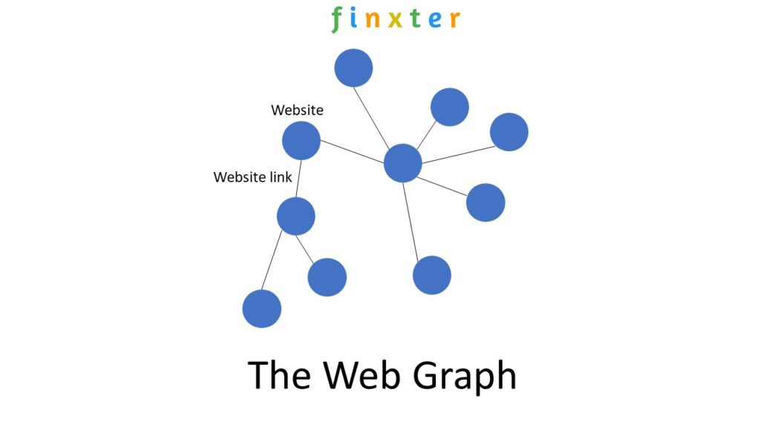

Slide 5
What is Link Analysis?
Uses link structure of the web
Measures importance of web pages
Improves ranking in IR systems
Main algorithms: PageRank and HITS

Slide 6
PageRank: Random Surfer Story
User starts from any random page
Clicks links randomly
Keeps browsing continuously
Pages visited more often are important

Slide 7
PageRank: Key Ideas
More incoming links = more importance
Links from important pages matter more
Every link passes some rank value

Slide 8
Damping Factor in PageRank
User may get bored
Teleports to random page
Damping factor = 0.85
Prevents dead ends

Slide 9
PageRank Formula (Basic)
PR(u) = (1-d)/N + d * sum(PR(v)/L(v))
Understand idea, not calculation
Rank flows through links
Bu → Pages linking to u
L(v) → Number of links from v

Slide 10
B ─────► A
│
└─────► C
C ─────► A
D ──► A
│
├──► B
│
└──► C

Slide 11
Initial PageRank
Initially, all pages are equally important
PageRank is a probability distribution
PR(A) = PR(B) = PR(C) = PR(D) = 0.25

Slide 12
PageRank Flow (Money Analogy 💰)
PageRank is divided equally among outgoing links
More outgoing links → less value per link

Slide 13
Page | PR | Outgoing Links | Contribution
B | 0.25 | 2 | 0.125
C | 0.25 | 1 | 0.25
D | 0.25 | 3 | 0.083

Slide 14
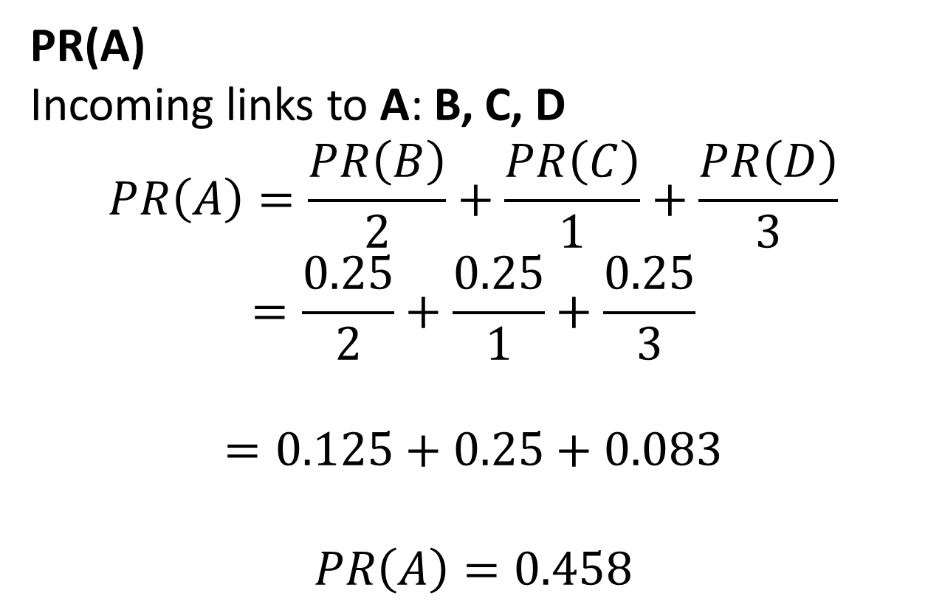
PageRank Calculation for Page A
PR(A)
Incoming links to A: B, C, D
$$PR\left(A\right)=\frac{PR\left(B\right)}{2}+\frac{PR\left(C\right)}{1}+\frac{PR\left(D\right)}{3}$$
$$=\frac{0.25}{2}+\frac{0.25}{1}+\frac{0.25}{3}$$
$$=0.125+0.25+0.083$$
$$PR\left(A\right)=0.458$$

Slide 15
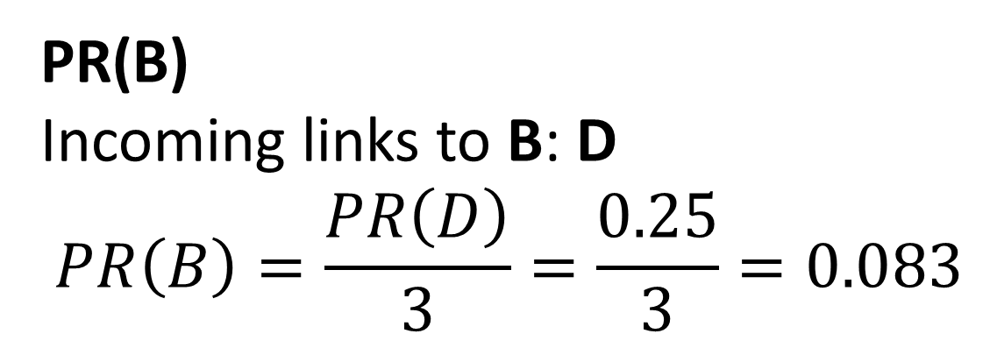
PageRank Calculation for Page B
PR(B)
Incoming links to B: D
$$PR\left(B\right)=\frac{PR\left(D\right)}{3}=\frac{0.25}{3}=0.083$$

Slide 16
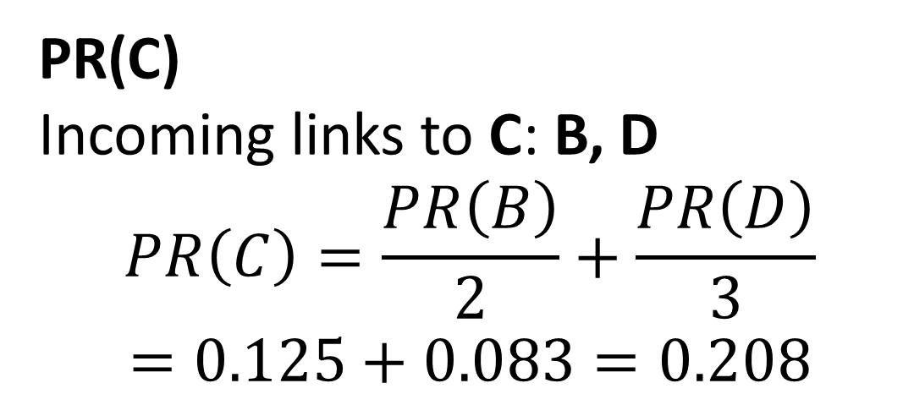
PageRank Calculation for Page C
PR(C)
Incoming links to C: B, D
$$PR\left(C\right)=\frac{PR\left(B\right)}{2}+\frac{PR\left(D\right)}{3}$$
$$=0.125+0.083=0.208$$

Slide 17

PageRank Calculation for Page D
Incoming links to D: none
$$PR\left(D\right)=0$$

Slide 18
After Iteration 1
Page | PR
A | 0.458
B | 0.083
C | 0.208
D | 0

Slide 19
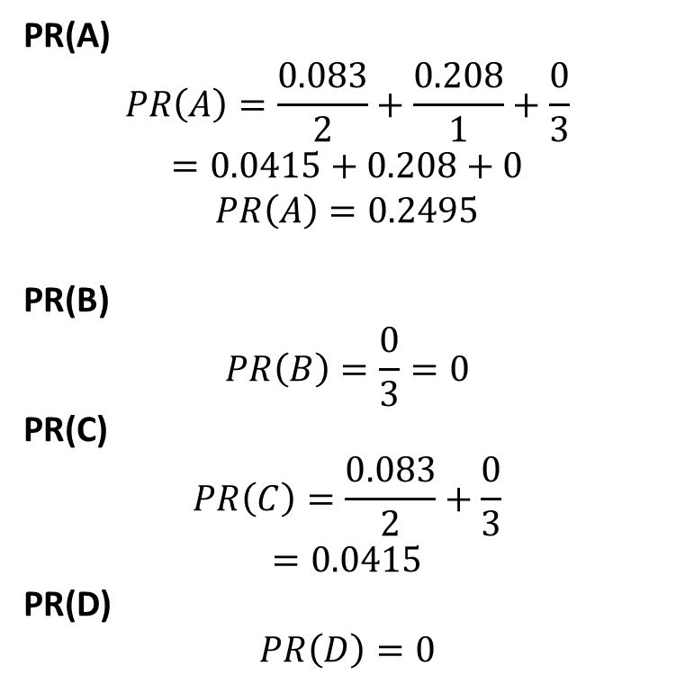
🔁 ITERATION 2
PR(A)
$$PR\left(A\right)=\frac{0.083}{2}+\frac{0.208}{1}+\frac{0}{3}$$
$$=0.0415+0.208+0$$
$$PR\left(A\right)=0.2495$$
PR(B)
$$PR\left(B\right)=\frac{0}{3}=0$$
PR(C)
$$PR\left(C\right)=\frac{0.083}{2}+\frac{0}{3}$$
$$=0.0415$$
PR(D)
$$PR\left(D\right)=0$$

Slide 20
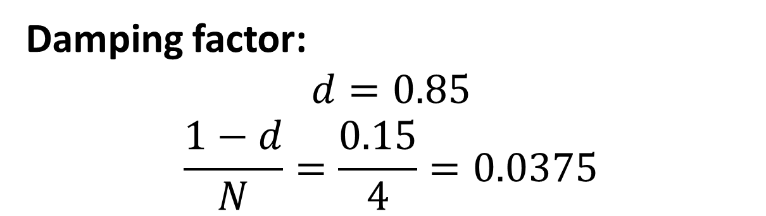
Now the SAME Example WITH DAMPING
Damping factor:
$$d=0.85$$
$$\frac{1−d}{N}=\frac{0.15}{4}=0.0375$$

Slide 21
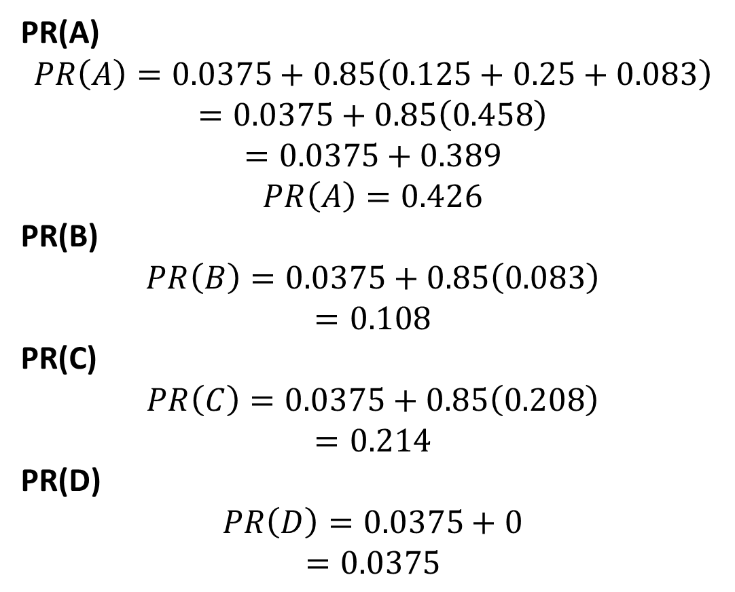
Iteration 1 WITH DAMPING
PR(A)
$$PR\left(A\right)=0.0375+0.85\left(0.125+0.25+0.083\right)$$
$$=0.0375+0.85\left(0.458\right)$$
$$=0.0375+0.389$$
$$PR\left(A\right)=0.426$$
PR(B)
$$PR\left(B\right)=0.0375+0.85\left(0.083\right)$$
$$=0.108$$
PR(C)
$$PR\left(C\right)=0.0375+0.85\left(0.208\right)$$
$$=0.214$$ PR(D)
$$PR\left(D\right)=0.0375+0$$
$$=0.0375$$

Slide 22
Iterative Process
Initialize PR
↓
Distribute PR via links
↓
Update PR values
↓
Repeat until stable

Slide 23
Applications of PageRank
Google search ranking
Web crawling priority
Spam reduction

Slide 24
HITS Algorithm
(Hyperlink-Induced Topic Search)

Slide 25
HITS Algorithm Overview
Used for topic-specific search
Works after query is given
Analyzes relevant pages only

Slide 26
HITS: Authorities
Pages with real information
Experts on the topic
Example: Wikipedia, official docs

Slide 27
HITS: Hubs
Pages that link to good authorities
Act as guides
Example: Resource list blogs

Slide 28
Authority vs Hub
Feature | Authority | Hub
Links | Incoming | Outgoing
Meaning | Important content | Reference page
Depends on | Who points to me | Who I point to

Slide 29
Mutual Reinforcement
Good hubs point to good authorities
Good authorities are linked by good hubs
Scores updated repeatedly

Slide 30
Characteristics of HITS
Query dependent
Computed online
Produces hub and authority scores

Slide 31
Basic Working of HITS
Select a set of relevant pages
Initialize authority and hub scores
Repeatedly update:
Authority scores
Hub scores
Normalize scores
Stop when values converge

Slide 32
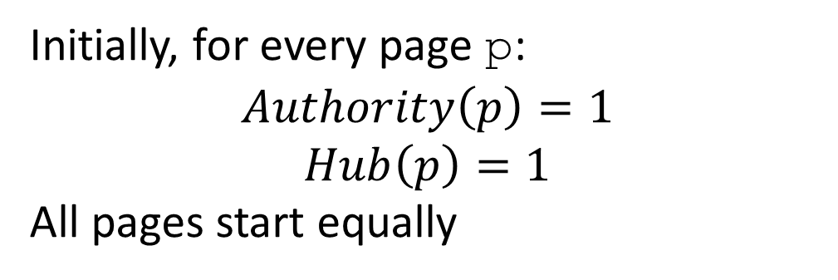
Initialization
Initially, for every page p:
$$Authority\left(p\right)=1$$
$$Hub\left(p\right)=1$$
All pages start equally

Slide 33
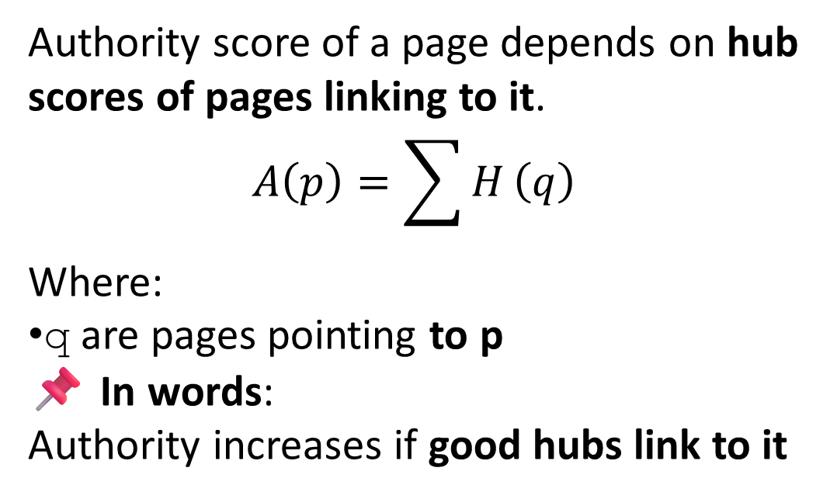
Authority Update Rule
Authority score of a page depends on hub scores of pages linking to it.
$$A\left(p\right)=\sum{H}\left(q\right)$$
Where:
q are pages pointing to p
📌 In words:
Authority increases if good hubs link to it

Slide 34
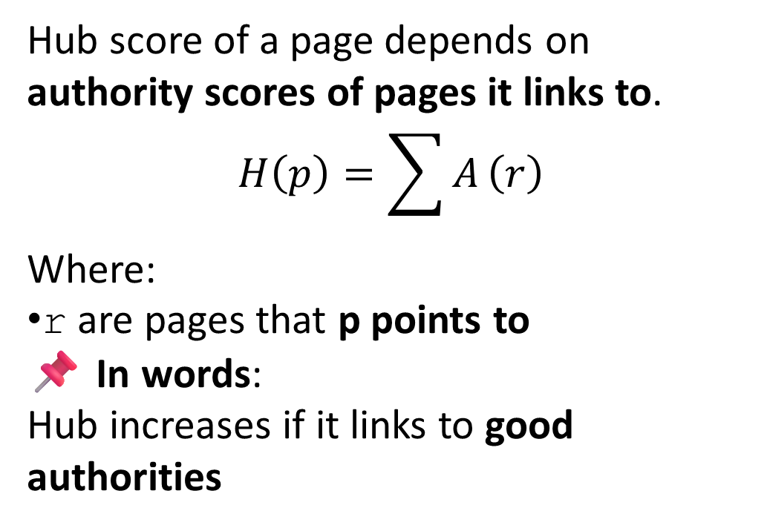
Hub Update Rule
Hub score of a page depends on authority scores of pages it links to.
$$H\left(p\right)=\sum{A}\left(r\right)$$
Where:
r are pages that p points to
📌 In words:
Hub increases if it links to good authorities

Slide 35
Example Link Structure
A ───► C
B ───► C
B ───► D
C ───► D

Slide 36
Iteration 1 – Authority Calculation
A(A) = 0 (no incoming links)
A(B) = 0
A(C) = H(A) + H(B) = 1 + 1 = 2
A(D) = H(B) + H(C) = 1 + 1 = 2
Authorities depend on incoming links only

Slide 37
Iteration 1 – Hub Calculation
H(A) = A(C) = 2
H(B) = A(C) + A(D) = 2 + 2 = 4
H(C) = A(D) = 2
H(D) = 0
Hubs depend on outgoing links only

Slide 38
Scores after Iteration 1
Page | Authority | Hub
A | 0 | 2
B | 0 | 4
C | 2 | 2
D | 2 | 0

Slide 39
Final Result
C & D → Authorities
B → Best Hub
A → Weak authority but decent hub

Slide 40
PageRank vs HITS
PageRank: Global ranking
HITS: Query-based ranking
PageRank: One score
HITS: Two scores

Slide 41
Applications of Link Analysis
Improves search result quality
Spam detection
Community detection

Slide 42
Summary
Web represented as graph
Links act as votes
PageRank finds popularity
HITS finds experts and guides

